Slide 1
Project:Image Recognition with IBM Cloud Visual recognition
Phase 2: INNOVATION
Submitted by:
Abinish A
Mandira Moorthy M
Sree Kanth B
Jose Rakshan A
Arockia Adam Vishal J
Anto Rajool M

Slide 2
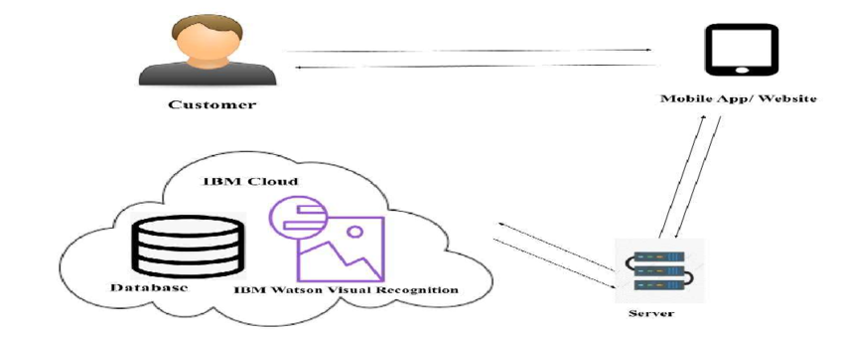
Image Recognition with IBM Cloud Visual recognition

Slide 3
Introduction
IBM Cloud Visual Recognition is a service provided by IBM as part of their cloud offerings. It's designed to analyze and classify visual content, making it particularly useful for applications that involve image or video processing. Here's an introduction to IBM Cloud Visual Recognition.M Cloud Visual Recognition is used to understand and analyze visual content within images or videos. It can identify objects, scenes, and even extract text from images.It can classify images into predefined categories or custom classes you define.Recognizes and identifies faces within images. Allows businesses to adapt the service to their specific needs.Overall, IBM Cloud Visual Recognition is a powerful tool for businesses and developers looking to incorporate image and video analysis capabilities into their applications, and it's part of IBM's broader suite of cloud services

Slide 4
IBM Cloud Visual Recognition has a wide range of applications across various industries. Here are some common uses:
*E-commerce and Retail*: -*Product Identification*: Automatically tag and categorize products in e-commerce catalogs based on images. - *Visual Search*: Enable users to find similar products by uploading images. - *Quality Control*: Detect defects or irregularities in products during manufacturing.
*Healthcare*: - *Medical Image Analysis*: Assist in diagnosing diseases or conditions through the analysis of medical images like X-rays, MRIs, and CT scans. - *Patient Identification*: Verify patients by matching their photos with their medical records.
*Security and Surveillance*: - *Facial Recognition*: Identify individuals in security footage for access control or investigation purposes. - *Object Detection*: Alert security personnel to specific objects or behaviors.
*Content Moderation*: - *Filtering Explicit Content*: Automatically detect and filter out inappropriate or explicit content in user-generated images or videos. - *Community Guidelines Enforcement*: Ensure that content shared on platforms complies with community standards.
*Automotive Industry*: - *Autonomous Vehicles*: Assist in object recognition and obstacle avoidance for self-driving cars. - *Driver Monitoring*: Monitor driver behavior and attention levels using facial recognition.

Slide 5
PROGRAM
import com.ibm.cloud.sdk.core.security.IamAuthenticator;
import com.ibm.watson.visual_recognition.v3.VisualRecognition;
importcom.ibm.watson.visual_recognition.v3.model.ClassifiedImages;
import com.ibm.watson.visual_recognition.v3.model.ClassifyOptions;
import com.ibm.watson.visual_recognition.v3.util.IamTokenManager;
public class IBMVisualRecognitionExample
{
public static void main(String[] args)
{
String apiKey = "YOUR_API_KEY";
String serviceUrl = "YOUR_SERVICE_URL";
IamAuthenticator authenticator = new IamAuthenticator(apiKey); authenticator.setServiceUrl(serviceUrl);
VisualRecognition visualRecognition = new VisualRecognition("2018-03-19", authenticator);
ClassifyOptions options = new ClassifyOptions.Builder().imagesFile(new File("path_to_your_image.jpg")).threshold(0.6) // You can adjust the confidence threshold.build();
ClassifiedImages result = visualRecognition.classify(options).execute().getResult(); System.out.println(result);
}
}

Slide 6
OUTPUT:
ClassifiedImages result = visualRecognition.classify(options).execute().getResult();
List<DetectedClass> classes = result.getImages().get(0).getClassifiers().get(0).getClasses();
for (DetectedClass detectedClass : classes)
{
String className = detectedClass.getClassName();
Double score = detectedClass.getScore(); System.out.println("Class: " + className + ", Score: " + score);
}

Slide 7
CONCLUSION
In conclusion, IBM Cloud Visual Recognition is a powerful and versatile tool that enables businesses and developers to incorporate advanced image and video analysis capabilities into their applications. Its wide range of features, including image classification, facial recognition, object detection, and custom model training, makes it applicable to a diverse set of industries and use cases.
By leveraging deep learning models and advanced algorithms, IBM Cloud Visual Recognition delivers accurate and reliable results in tasks such as product identification, medical image analysis, security and surveillance, content moderation, and more. Its ability to process and analyze visual content efficiently not only saves time but also enhances the accuracy of decision-making processes.
Furthermore, the flexibility of IBM Cloud Visual Recognition allows for customization to meet specific business needs. This means businesses can train the model with their own datasets, enabling it to recognize unique objects or patterns relevant to their operations.
The service's integration capabilities through APIs make it seamless to incorporate into existing applications and workflows, whether it's for e-commerce, healthcare, security, manufacturing, or other industries. Additionally, IBM Cloud Visual Recognition benefits from being part of the broader suite of cloud services offered by IBM, providing a comprehensive platform for businesses seeking cutting-edge solutions in visual content analysis.

